Slide 1
Recalibrating Human Brain Using UNET Architecture

Slide 2
Content
Introduction
UNET 2D
UNET 3D- SE
UNET 3D-PE

Slide 3
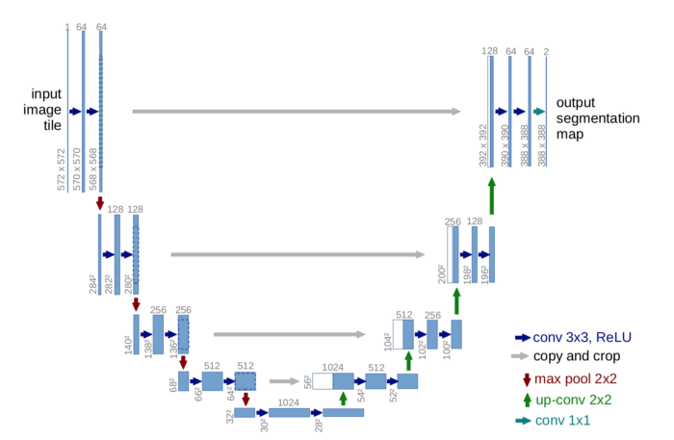
UNET- 2D
Dataset- Kaggle Brain Tumor Image Data
UNET Architecture

Slide 4
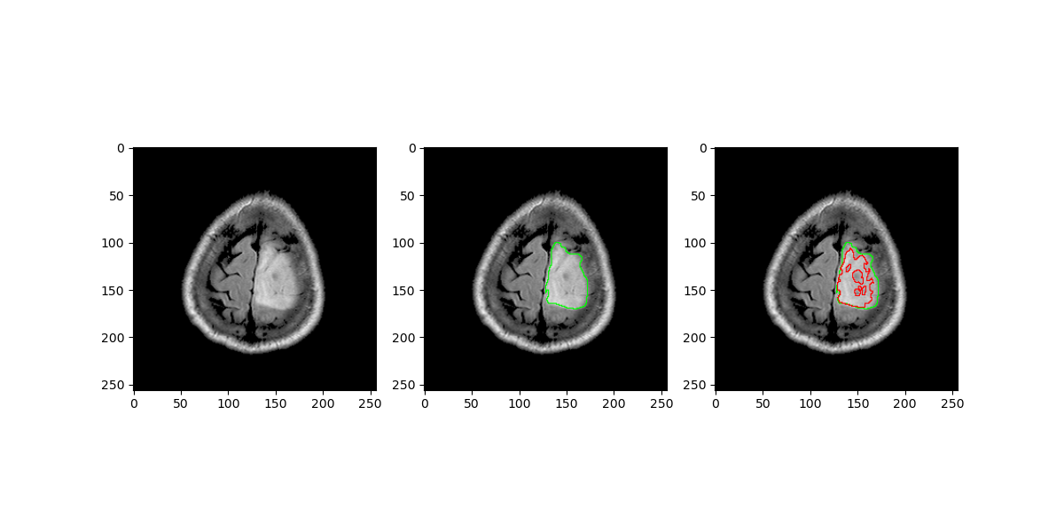
Training- SGD optimizer
- Learning rate- 0.01
- Number of epoch- 50
- Number of workers- 6
Squeeze and Excitation Module
Generated Result

Slide 5

Squeeze and Excitation Module
Squeeze:
Squeeze global spatial information into channel descriptor.
Using Global Average Pooling(GAP).
Excitation:
Fully capture channel- wise dependencies.

Slide 6
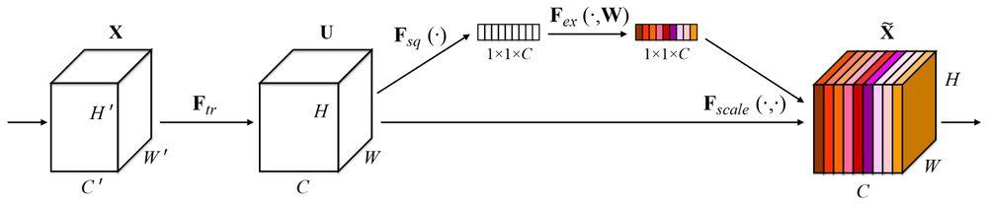
Squeeze and Excitation Module
Squeeze and Excitation Pipeline

Slide 7
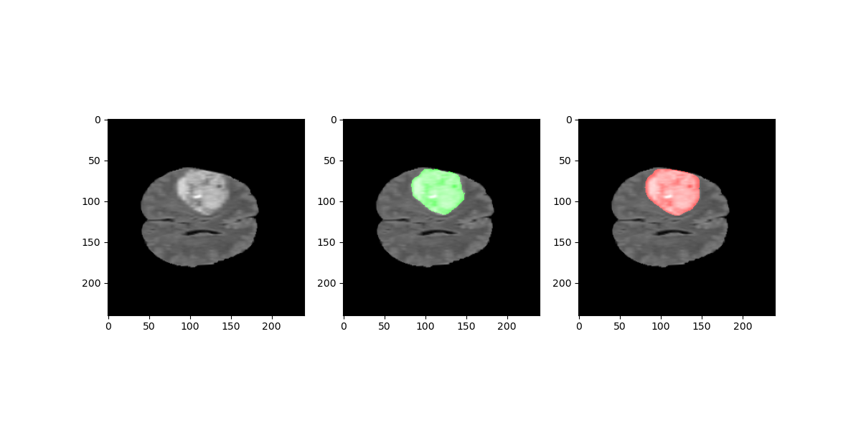
UNET 3D SE
Dataset- Medical Segmentation Decathlon
Preprocessing
UNET Architecture
Training
Inferencing and Visualization
Generated Result

Slide 8
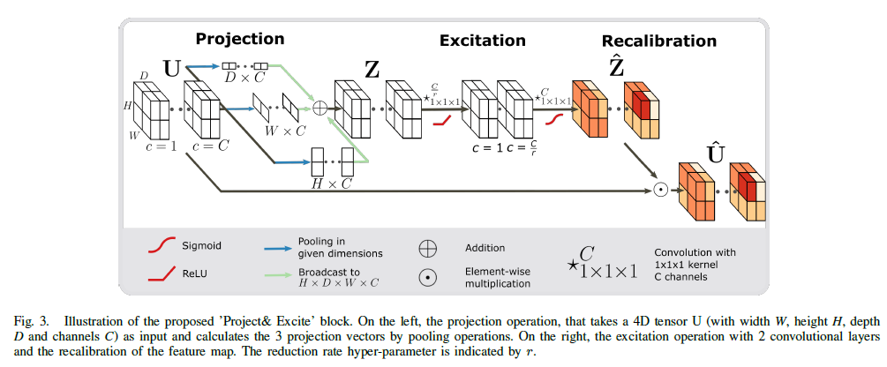
UNET 3D PE

Slide 9
Thank You

